Slide 1

Feedback Control System Unit 2 Block Diagrams and Signal flow graphs

Slide 2
Components of a block diagram for a LTI system
Signals system
Summing junction pickoff point

Slide 3
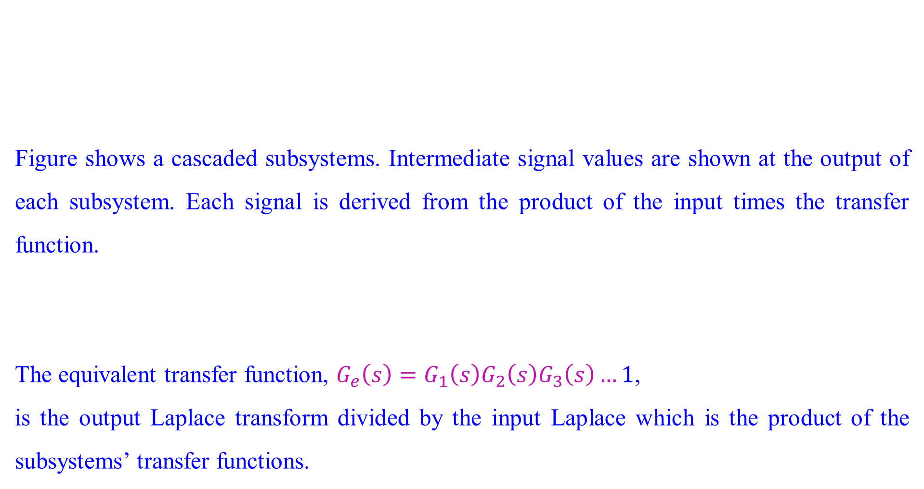
Cascade Form
Figure shows a cascaded subsystems. Intermediate signal values are shown at the output of each subsystem. Each signal is derived from the product of the input times the transfer function.
The equivalent transfer function, $G_{e}\left(s\right)=G_{1}\left(s\right)G_{2}\left(s\right)G_{3}\left(s\right)…1$,
is the output Laplace transform divided by the input Laplace which is the product of the subsystems’ transfer functions.

Slide 4
Cascade Form
Equation (1) was derived under the assumption that interconnected sub systems do not load adjacent subsystems. That is,
a subsystem’s output remains the same whether the subsequent subsystem is connected or not.
If there is a change in the output the subsequent subsystem loads the previous subsystem, and the equivalent transfer function is not the product of the individual transfer functions.

Slide 5
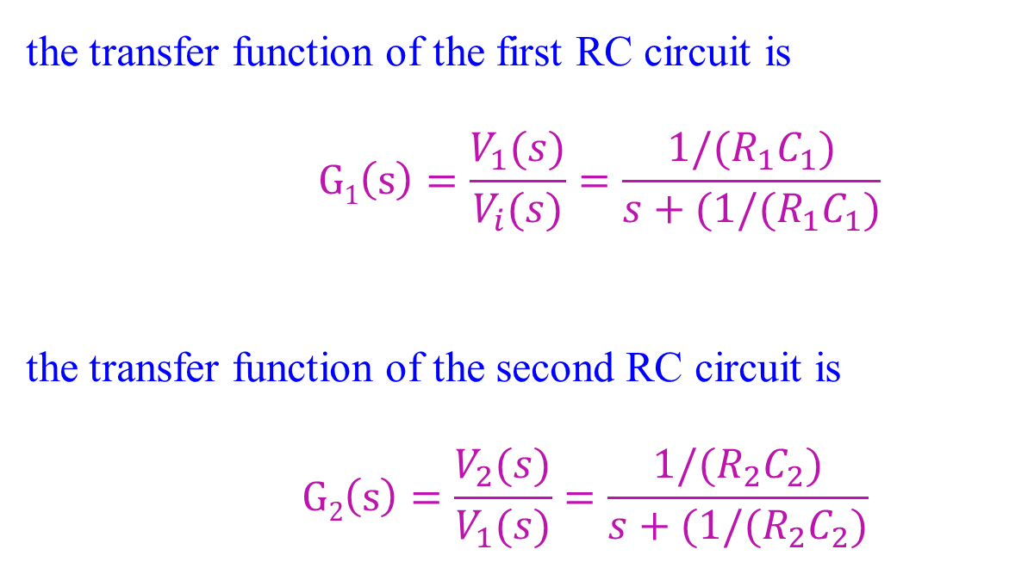
Cascade Form
the transfer function of the first RC circuit is
$$G1\left(s\right)=\frac{V_{1}(s)}{V_{i}(s)}=\frac{1/(R_{1}C_{1})}{s+(1/(R_{1}C_{1})}$$
the transfer function of the second RC circuit is
$$G2\left(s\right)=\frac{V_{2}(s)}{V_{1}(s)}=\frac{1/(R_{2}C_{2})}{s+(1/(R_{2}C_{2})}$$
1
2
If we couple both the circuits to have cascaded combination, then we get

Slide 6
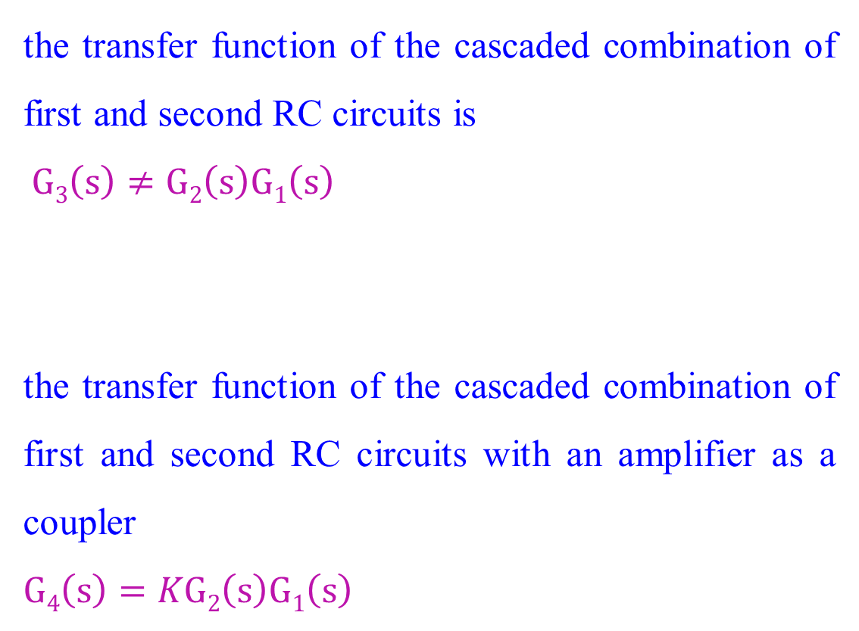
Cascade Form
3
4
the transfer function of the cascaded combination of first and second RC circuits is
$$G3\left(s\right)≠G2\left(s\right)G1\left(s\right)$$
the transfer function of the cascaded combination of first and second RC circuits with an amplifier as a coupler
$$G4\left(s\right)=KG2\left(s\right)G1\left(s\right)$$

Slide 7
Cascade Form
To prevent loading is to use an amplifier between the two networks.
The amplifier has a high-impedance input, so that it does not load the previous network.
At the same time, it has a low-impedance output, so that it looks like a pure voltage source to the subsequent network.
With the amplifier included, the equivalent transfer function is the product of the transfer functions and the gain, K, of the amplifier.

Slide 8
Parallel Form
Figure shows an example of parallel subsystems. Again, by writing the output of each subsystem, we can find the equivalent transfer function.
Parallel subsystems have a common input and an output formed by the algebraic sum of the outputs from all of the subsystems.

Slide 9
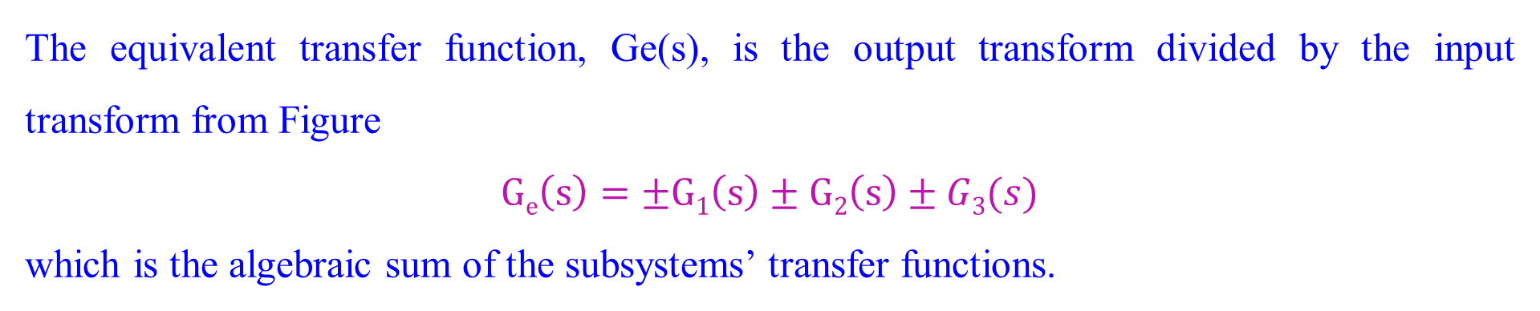
Parallel Form
The equivalent transfer function, Ge(s), is the output transform divided by the input transform from Figure
$$Ge\left(s\right)=±G1\left(s\right)±G2\left(s\right)±G3(s)$$
which is the algebraic sum of the subsystems’ transfer functions.

Slide 10
Feedback Form
The typical feedback system.

Slide 11
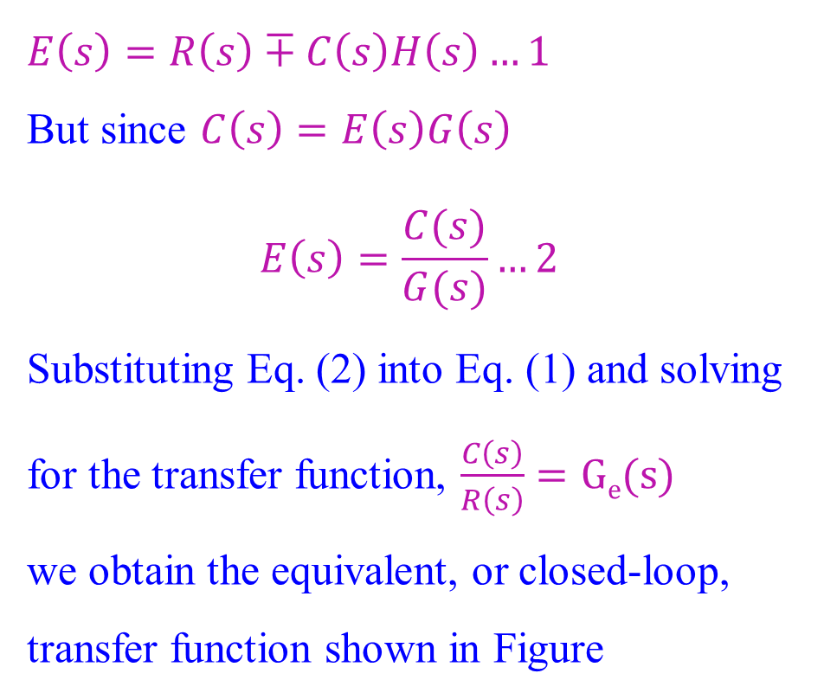
Feedback Form
The simplified model of feedback system.
$$E\left(s\right)=R\left(s\right)∓C\left(s\right)H\left(s\right)…1$$
But since $C\left(s\right)=E\left(s\right)G\left(s\right)$
$$E\left(s\right)=\frac{C(s)}{G(s)}…2$$
Substituting Eq. (2) into Eq. (1) and solving for the transfer function, $\frac{C\left(s\right)}{R\left(s\right)}=Ge(s)$
we obtain the equivalent, or closed-loop, transfer function shown in Figure

Slide 12
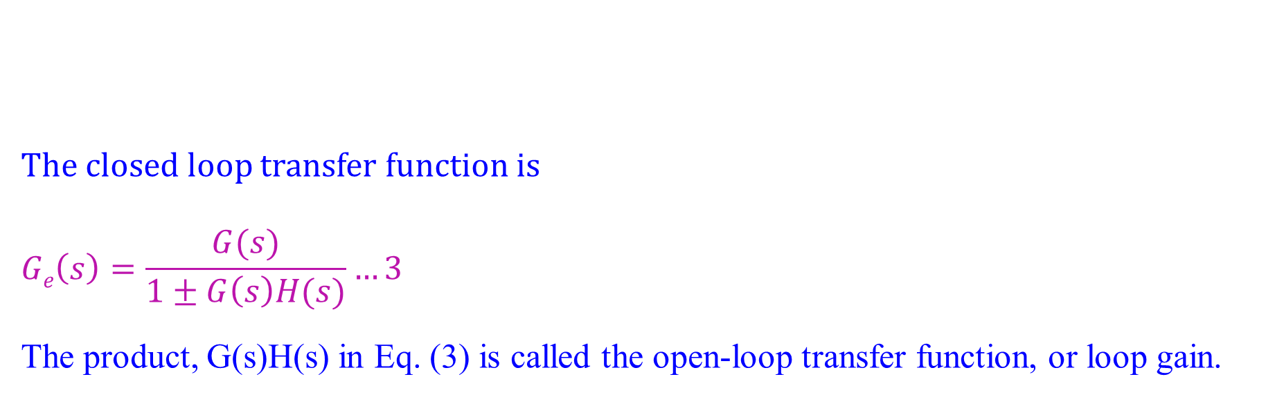
Feedback Form
The closed loop transfer function is
$$Ge\left(s\right)=\frac{G(s)}{1±G\left(s\right)H(s)}…3$$
The product, G(s)H(s) in Eq. (3) is called the open-loop transfer function, or loop gain.

Slide 13
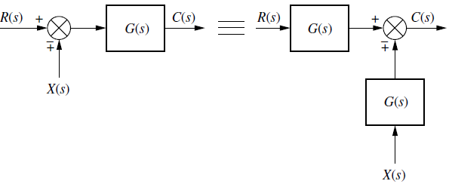

Feedback Form: Block diagram algebra for summing junctions
Block diagram algebra for summing junctions - equivalent forms for moving a block to the left past a summing junction
The signals $R\left(s\right)$and $X\left(s\right)$are multiplied by $G\left(s\right)$before reaching the output. Hence, both block diagrams are equivalent, with $C\left(s\right)=R\left(s\right)G(s)∓X\left(s\right)G(s)$

Slide 14
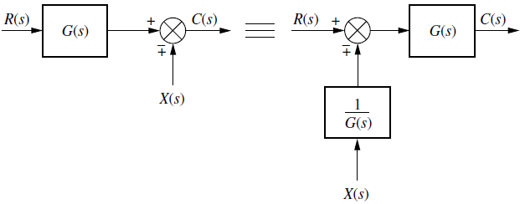

Feedback Form: Block diagram algebra for summing junctions
Block diagram algebra for summing junctions - equivalent forms for moving a block to the right past a summing junction. $R\left(s\right)$is multiplied by $G\left(s\right)$ before reaching the output, but $X\left(s\right)$is not. Hence, both block diagrams in Figure are equivalent, with$C\left(s\right)=R\left(s\right)G(s)∓X\left(s\right)$

Slide 15
Feedback Form: Block diagram algebra for pickoff points
Block diagram algebra for pickoff points - equivalent forms for moving a block to the left past a pickoff point

Slide 16
Feedback Form: Block diagram algebra for pickoff points
Block diagram algebra for pickoff points - equivalent forms for moving a block to the right past a pickoff point

Slide 17
Block Diagram Reduction Rules
Follow these rules for simplifying (reducing) the block diagram, which is having many blocks, summing points and take-off points.
Rule 1 − Check for the blocks connected in series and simplify.
Rule 2 − Check for the blocks connected in parallel and simplify.
Rule 3 − Check for the blocks connected in feedback loop and simplify.
Rule 4 − If there is difficulty with take-off point while simplifying, shift it towards right.
Rule 5 − If there is difficulty with summing point while simplifying, shift it towards left.
Rule 6 − Repeat the above steps till you get the simplified form, i.e., single block.

Slide 18
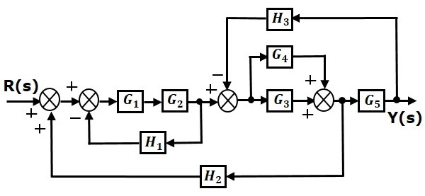
Block Diagram Reduction Rules
Numerical: Consider the block diagram shown in the following figure. Let us simplify (reduce) this block diagram using the block diagram reduction rules.

Slide 19
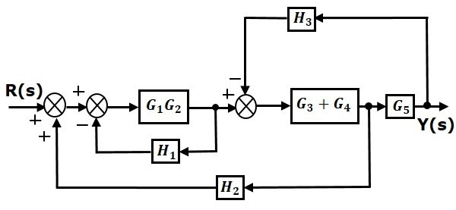
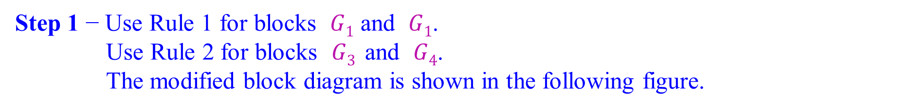
Block Diagram Reduction Rules
Step 1 − Use Rule 1 for blocks $G1$ and $G1$.
Use Rule 2 for blocks $G3$ and $G4$.
The modified block diagram is shown in the following figure.

Slide 20
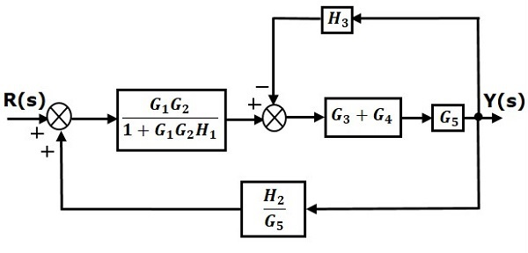
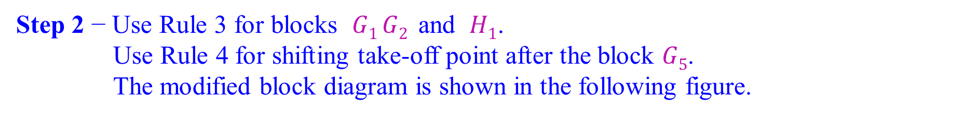
Block Diagram Reduction Rules
Step 2 − Use Rule 3 for blocks $G1 G2$ and $H1$.
Use Rule 4 for shifting take-off point after the block $G5$.
The modified block diagram is shown in the following figure.

Slide 21
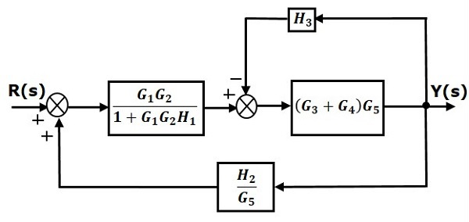
Block Diagram Reduction Rules
Step 3 − Use Rule 1 for blocks $(G3+G4)$ and $G5$.
The modified block diagram is shown in the following figure.

Slide 22
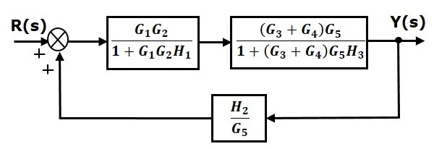
Block Diagram Reduction Rules
Step 4 − Use Rule 3 for blocks $\left(G3+G4\right)G5$ and $(H3)$.
The modified block diagram is shown in the following figure.

Slide 23
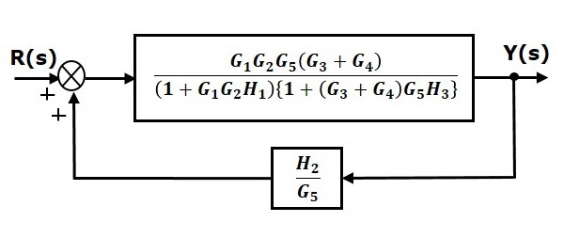
Block Diagram Reduction Rules
Step 5 − Use Rule 1 for blocks connected in series.
The modified block diagram is shown in the following figure.

Slide 24
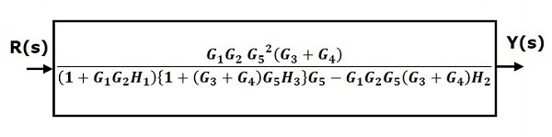
Block Diagram Reduction Rules
Step 6 − Use Rule 3 for blocks connected in feedback loop.
The modified block diagram is shown in the following figure.
This is the simplified block diagram.

Slide 25
Block diagram
Numerical: Reduce the block diagram to a single transfer function

Slide 26
Block diagram
Step1: The three summing junctions can be combined into a single summing junction

Slide 27
Block diagram
The three summing junctions can be combined into a single summing junction

Slide 28
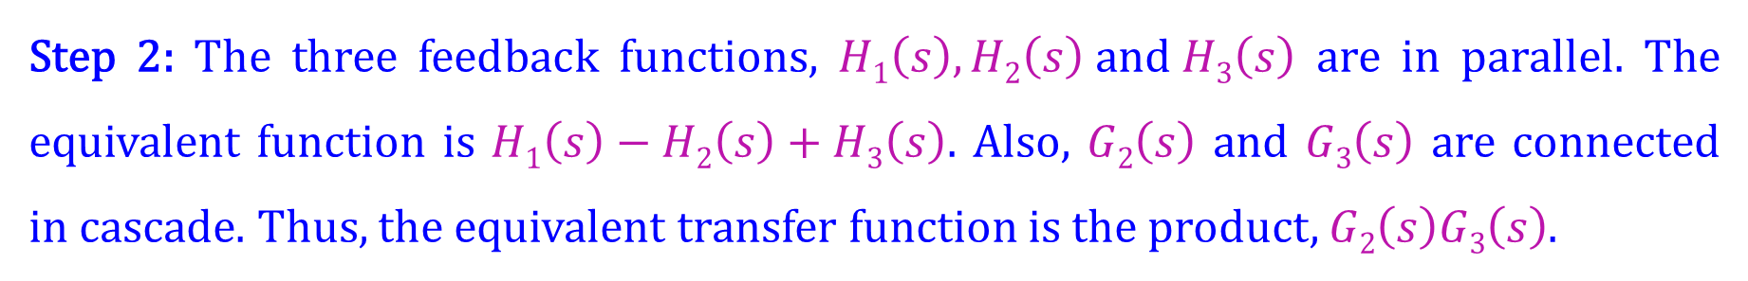
Block diagram
Step 2: The three feedback functions, $H1\left(s\right),H2\left(s\right) and H3\left(s\right)$ are in parallel. The equivalent function is $H1\left(s\right)−H2\left(s\right)+H3\left(s\right)$. Also, $G2\left(s\right)$ and $G3\left(s\right)$ are connected in cascade. Thus, the equivalent transfer function is the product, $G2\left(s\right)G3\left(s\right)$.

Slide 29
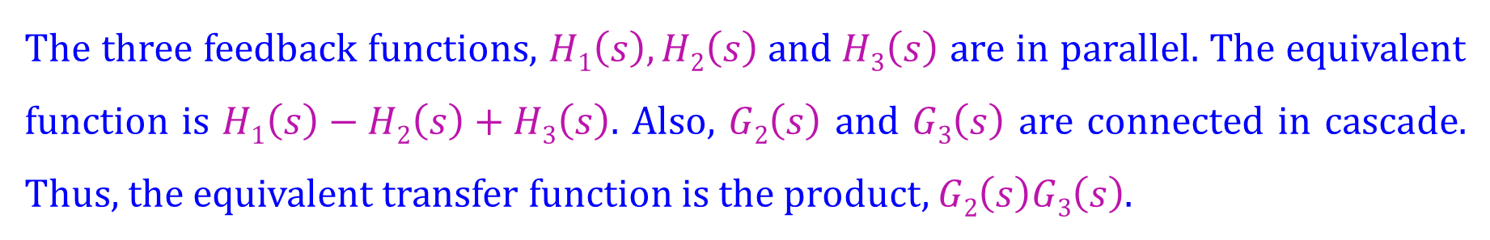
Block diagram
The three feedback functions, $H1\left(s\right),H2\left(s\right) and H3\left(s\right)$ are in parallel. The equivalent function is $H1\left(s\right)−H2\left(s\right)+H3\left(s\right)$. Also, $G2\left(s\right)$ and $G3\left(s\right)$ are connected in cascade. Thus, the equivalent transfer function is the product, $G2\left(s\right)G3\left(s\right)$.

Slide 30
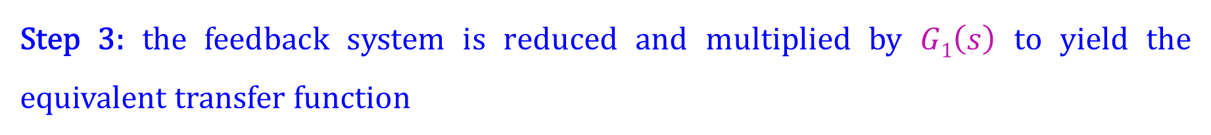
Block diagram
Step 3: the feedback system is reduced and multiplied by $G1\left(s\right)$ to yield the equivalent transfer function

Slide 31
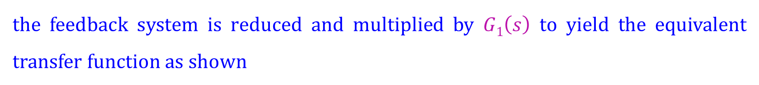
Block diagram
the feedback system is reduced and multiplied by $G1\left(s\right)$ to yield the equivalent transfer function as shown

Slide 32
Block diagram
Numerical: Reduce the block diagram shown to a single transfer function

Slide 33
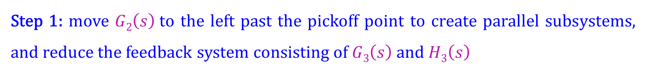
Block diagram
Step 1: move $G2\left(s\right)$to the left past the pickoff point to create parallel subsystems, and reduce the feedback system consisting of $G3\left(s\right)$and $H3\left(s\right)$

Slide 34
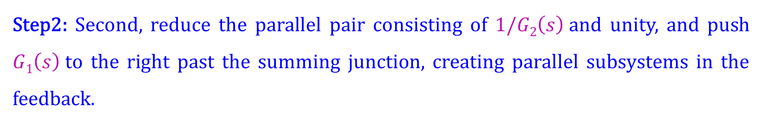
Block diagram
Step2: Second, reduce the parallel pair consisting of $1/G2\left(s\right)$and unity, and push $G1\left(s\right)$to the right past the summing junction, creating parallel subsystems in the feedback.

Slide 35
Block diagram
Step3: combine the summing junctions, add the two feedback elements together, and combine the last two cascaded blocks.

Slide 36
Block diagram
Step4: use the feedback formula.
Step5: Finally, multiply the two cascaded blocks and obtain the final result

Slide 37
Block diagram
Numerical: Reduce the block diagram and find the transfer function

Slide 38
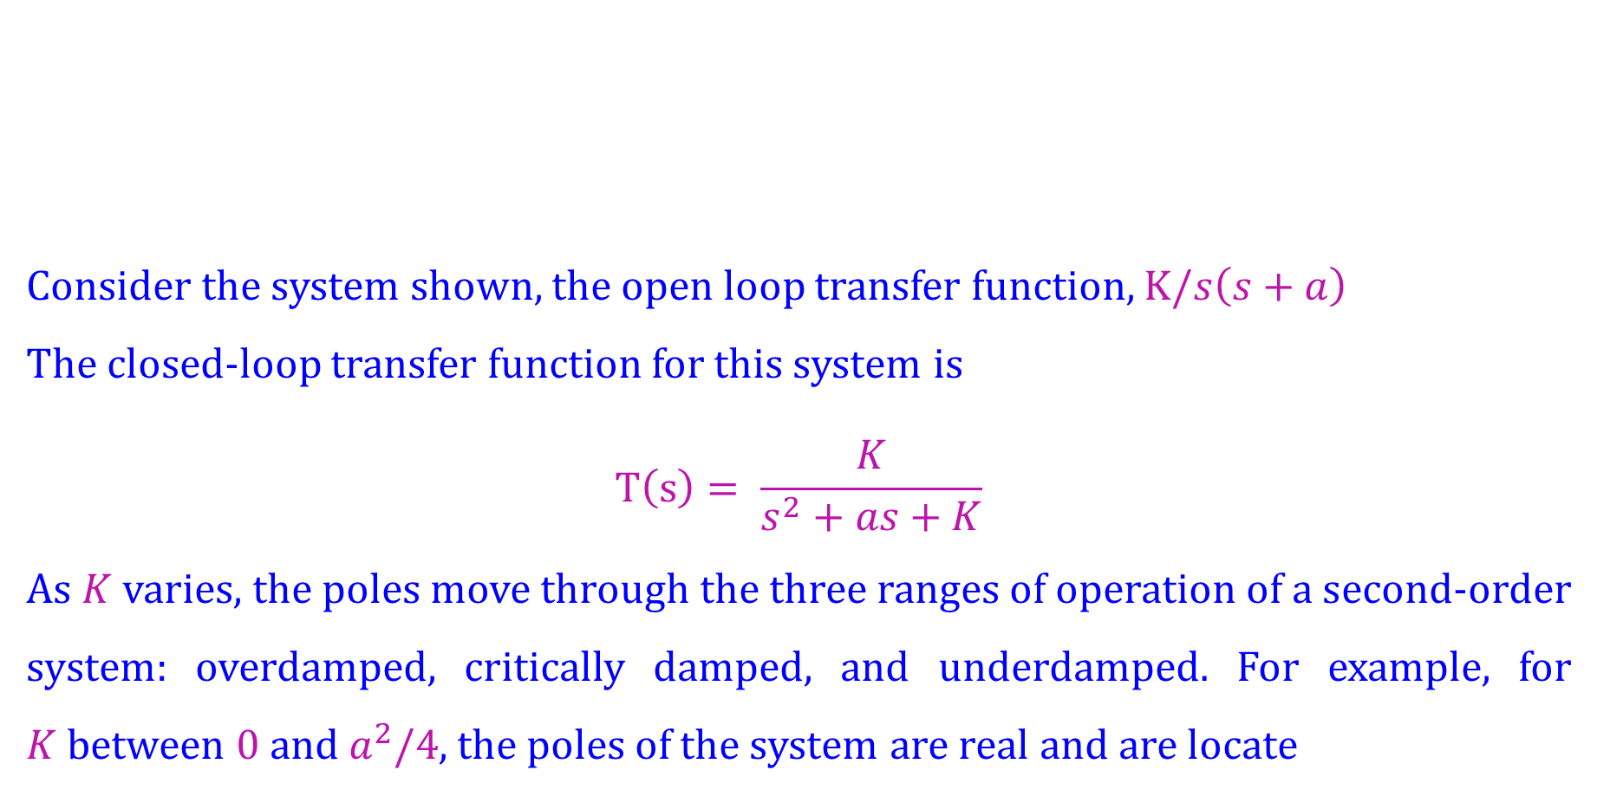
Analysis and Design of Feedback Systems
Consider the system shown, the open loop transfer function, $K/s\left(s+a\right)$
The closed-loop transfer function for this system is
$$T\left(s\right)= \frac{K}{s^{2}+as+K}$$
As $K$ varies, the poles move through the three ranges of operation of a second-order system: overdamped, critically damped, and underdamped. For example, for $K$between $0$and $a^{2}/4$, the poles of the system are real and are locate

Slide 39
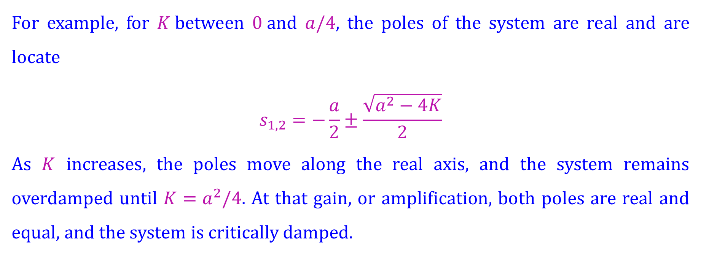
Analysis and Design of Feedback Systems
For example, for $K$between $0$and $a/4$, the poles of the system are real and are locate
$$s_{1,2}=−\frac{a}{2}±\frac{\sqrt{a^{2}−4K}}{2}$$
As $K$ increases, the poles move along the real axis, and the system remains overdamped until $K=a^{2}/4$. At that gain, or amplification, both poles are real and equal, and the system is critically damped.

Slide 40
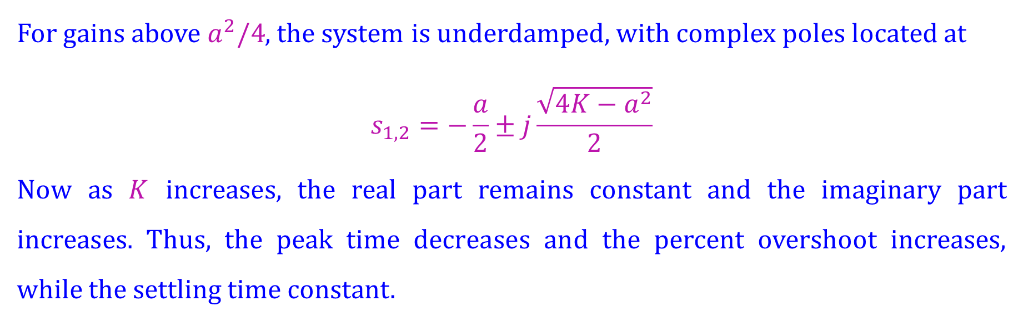
Analysis and Design of Feedback Systems
For gains above $a^{2}/4$, the system is underdamped, with complex poles located at
$$s_{1,2}=−\frac{a}{2}±j\frac{\sqrt{4K−a^{2}}}{2}$$
Now as $K$ increases, the real part remains constant and the imaginary part increases. Thus, the peak time decreases and the percent overshoot increases, while the settling time constant.

Slide 41

Analysis and Design of Feedback Systems
For the system shown, find the peak time,
The closed-loop transfer function found from is
$$T\left(s\right)=\frac{25}{s^{2}+5s+25}$$
$$ω_{n}=\sqrt{25}=5;2ζω_{n}=5; ∴ζ=0.5$$

Slide 42

Analysis and Design of Feedback Systems
Using the values for $ζ$ and $ω_{n}$ we find respectively
$$T_{p}=\frac{π}{ω_{n}\sqrt{1−ζ^{2}}}=0.726 second$$
$$\%OS=\frac{e^{ζπ}}{\sqrt{1−ζ^{2}}}×100=16.303$$
$$T_{s}=\frac{4}{{ζω}_{n}}=1.6 second$$

Slide 43
Signal-Flow Graphs
Signal-flow graphs are an alternative to block diagrams. The signal-flow graph consists of
branches which represent systems, and
nodes, which represent signals.
System node (signal)
A system is represented by a line with an arrow showing the direction of signal flow through the system. Adjacent to the line we write the transfer function.
A signal is a node with the signal’s name written adjacent to the node.

Slide 44
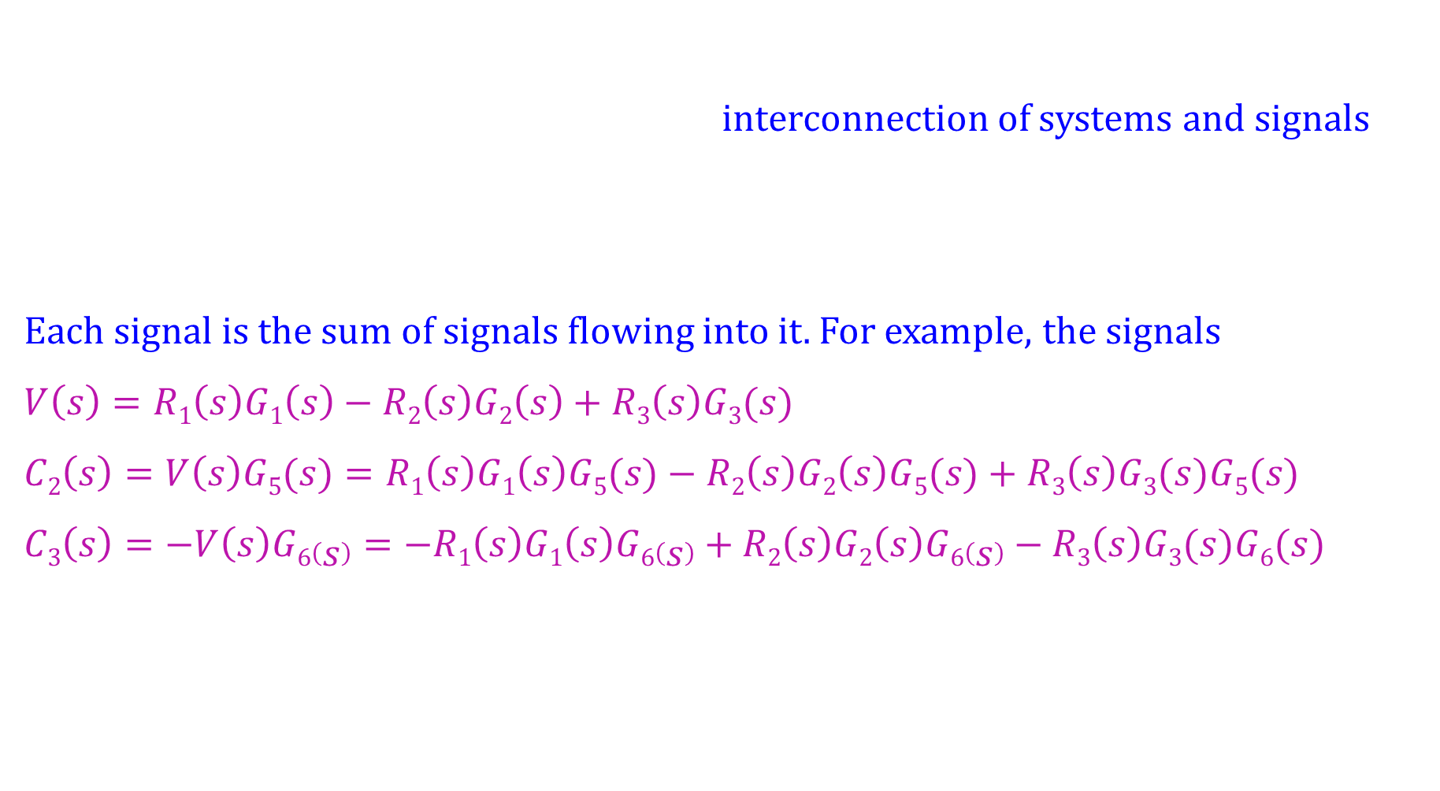
Signal-Flow Graphs
interconnection of systems and signals
Each signal is the sum of signals flowing into it. For example, the signals
$$V\left(s\right)=R1\left(s\right)G1\left(s\right)−R2\left(s\right)G2\left(s\right)+R3\left(s\right)G3(s)$$
$$C2\left(s\right)=V\left(s\right)G5(s)=R1\left(s\right)G1\left(s\right)G5(s)−R2\left(s\right)G2\left(s\right)G5(s)+R3\left(s\right)G3(s)G5(s)$$
$$C3\left(s\right)=−V\left(s\right)G6\left(s\right)=−R1\left(s\right)G1\left(s\right)G6\left(s\right)+R2\left(s\right)G2\left(s\right)G6\left(s\right)−R3\left(s\right)G3(s)G6(s)$$

Slide 45
Signal-Flow Graphs
Convert the block diagram into signal-flow graphs
Step1: Draw the signal nodes for that system.
Step2: Interconnect the signal nodes with system branches.

Slide 46
Signal-Flow Graphs
Convert the block diagram into signal-flow graphs
Step1: Draw the signal nodes for that system.

Slide 47
Signal-Flow Graphs
Step1: Draw the signal nodes for that system.
Step2: Interconnect the signal nodes with system branches.

Slide 48
Signal-Flow Graphs
Convert the block diagram into signal-flow graphs
Step1: Draw the signal nodes for that system.

Slide 49
Signal-Flow Graphs
Step1: Draw the signal nodes for that system.
Step2: Interconnect the signal nodes with system branches.

Slide 50
Signal-Flow Graphs
Convert the block diagram into signal-flow graphs
Step1: Draw the signal nodes for that system.

Slide 51
Signal-Flow Graphs
Step1: Draw the signal nodes for that system.

Slide 52
Signal-Flow Graphs
Step2: Interconnect the signal nodes with system branches.

Slide 53
Signal-Flow Graphs
Step3: Simplified signal flow graph

Slide 54
Mason’s Rule
Mason’s rule for reducing a signal-flow graph to a single transfer function requires the application of one formula. It has several components.

Slide 55
Mason’s Rule
Loop gain: The product of branch gains found by traversing a path that starts at a node and ends at the same node, following the direction of the signal flow, without passing through any other node more than once. Here we have four loops

Slide 56
Mason’s Rule
Forward-path gain: The product of gains found by traversing a path from the input node to the output node of the signal-flow graph in the direction of signal flow.
Here we have two forward-path gains:

Slide 57



Mason’s Rule
Forward-path gain: The product of gains found by traversing a path from the input node to the output node of the signal-flow graph in the direction of signal flow.
Here we have two forward-path gains:

Slide 58

Mason’s Rule
Nontouching loops:. Loops that do not have any nodes in common
Nontouching-loop gain: The product of loop gains from nontouching loops taken two, three, four, or more at a time. Here we have three sets of nontouching loops.

Slide 59
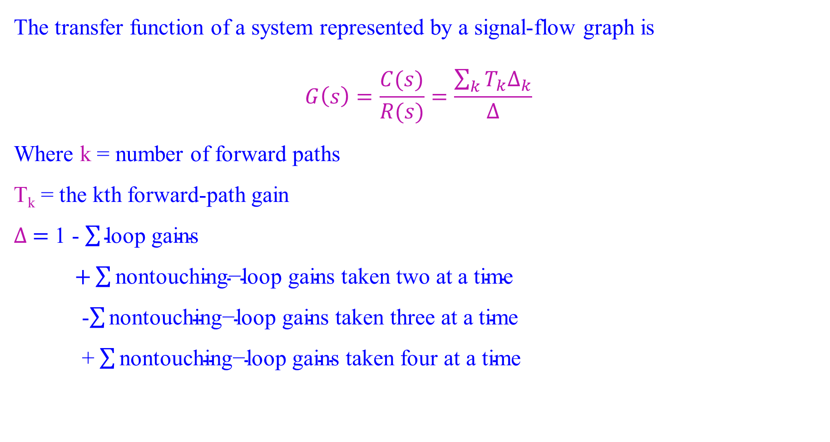
Mason’s Rule
The transfer function of a system represented by a signal-flow graph is
$$G\left(s\right)=\frac{C(s)}{R(s)}=\frac{\sum_{k}{T_{k}∆_{k}}}{∆}$$
Where k = number of forward paths
T_{k} = the kth forward-path gain
$∆ =$ 1 - $\sum{\text{loop} \text{gains}}$
$+\sum{\text{nontouching}\text{−}\text{loop} \text{gains} \text{taken} \text{two} \text{at} \text{a} \text{time}}$
-$\sum{\text{nontouching}\text{−}\text{loop} \text{gains} \text{taken} \text{three} \text{at} \text{a} \text{time}}$
+ $\sum{\text{nontouching}\text{−}\text{loop} \text{gains} \text{taken} \text{four} \text{at} \text{a} \text{time}}$

Slide 60
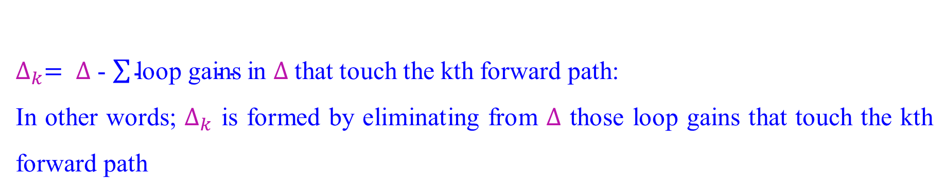

Mason’s Rule
$∆_{k}= ∆$ - $\sum{\text{loop} \text{gains}}$in $∆$that touch the kth forward path:
In other words; $∆_{k}$ is formed by eliminating from $∆$ those loop gains that touch the kth forward path

Slide 61
Mason’s Rule
Find the transfer function, C(s)/R(s), for the signal-flow graph

Slide 62
Mason’s Rule
Step1: Identify the forward-path gains. Here we have only one forward path

Slide 63
Mason’s Rule
Step2: Identify the loop gains. Here we have four, as follows:

Slide 64
Mason’s Rule
Step3: Identify the nontouching loops taken two at a time.
we can see that loop 1 does not touch loop 2, loop 1 does not touch loop 3, and loop 2 does not touch loop 3. Notice that loops 1, 2, and 3 all touch loop 4.

Slide 65
Mason’s Rule
Step4: Finally, the nontouching loops taken three at a time are as follows

Slide 66
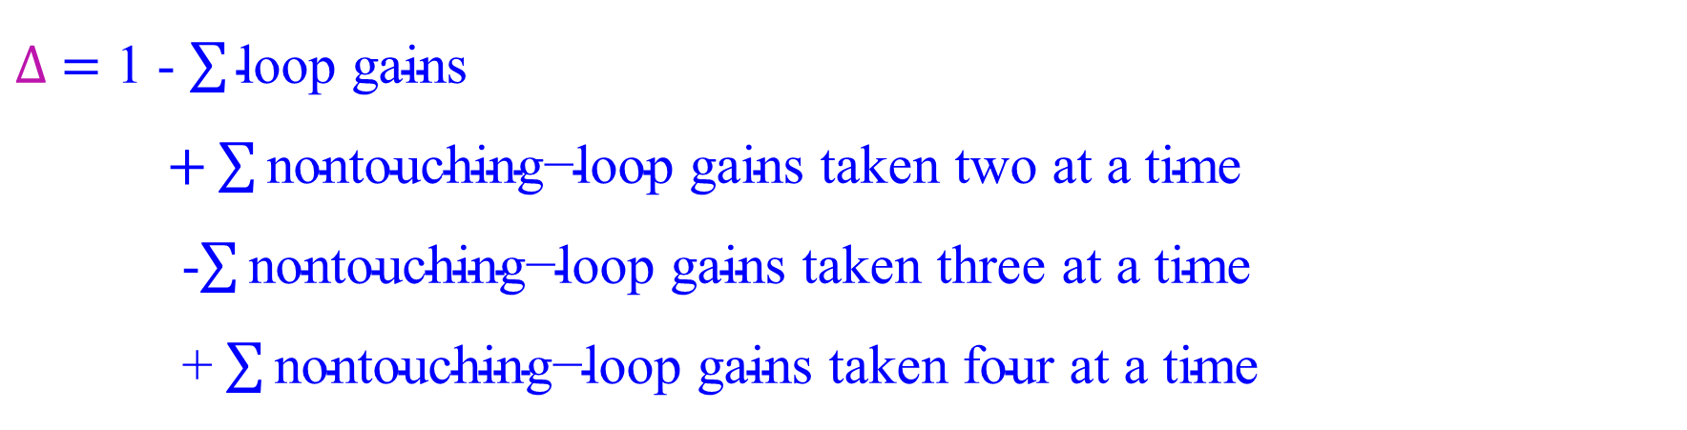
Mason’s Rule
Now find $∆ and ∆_{k}$
$∆ =$ 1 - $\sum{\text{loop} \text{gains}}$
$+\sum{\text{nontouching}\text{−}\text{loop} \text{gains} \text{taken} \text{two} \text{at} \text{a} \text{time}}$
-$\sum{\text{nontouching}\text{−}\text{loop} \text{gains} \text{taken} \text{three} \text{at} \text{a} \text{time}}$
+ $\sum{\text{nontouching}\text{−}\text{loop} \text{gains} \text{taken} \text{four} \text{at} \text{a} \text{time}}$

Slide 67
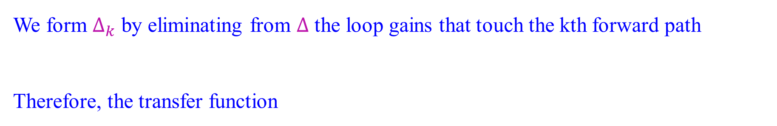
Mason’s Rule
We form $∆_{k}$ by eliminating from $∆$ the loop gains that touch the kth forward path
Therefore, the transfer function

